Slide 1
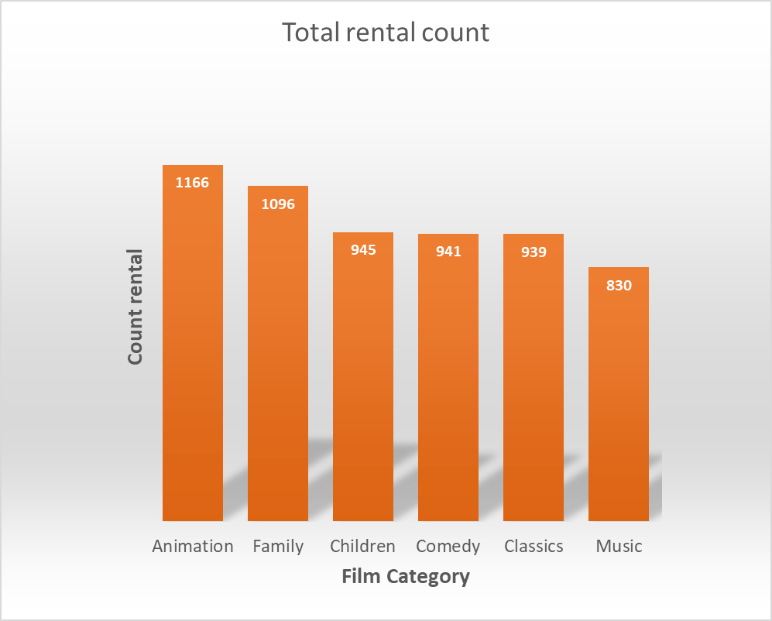
Question 1 - How many times were family movies rented out by category? + (Family movies= Animation or Children or Classics or Comedy or Family or music )
This graphic illustrates the rental count of family-friendly movies. Firstly, we can observe that movies from the film category ‘ Animation’ were rented out the most. Movies from the category ‘Music’ were rented out the least. Movies from the categories family, children, comedy and classics were less rented out compared to the animation category but more than the music category.

Slide 2
Question 2 – What is the amount of rental orders for each store per year?
This graphic illustrates the amount of films rented per store per year. Firstly we can observe that total rental count in 2005 was high almost equal for store 1 and store 2. Secondly, in 2006 we observe that rental count went down for both store 1 and store 2.

Slide 3
Question 3 - Who are the top 10 paying customers ? How much did each paid in total ?
This graphic illustrates the top 10 paying costumers and demonstrate how much they each paid. Firstly, we observe that Eleanor Hunt paid the most on films with 208,58 $, followed by Karl Seal, Marion Snyder with 194,61 $ and 191,62 $ respectively. The fourth, fifth and sixth position is taken by Rhonda Kennedy (189,6 $), Clara Shaw (183,63 $) and Tommy Collazo (167,67 $) respectively and shortly followed by Ana Bradlyey (167,62 $). On the 8th,9th and 10th position are Curtis Irby and Marcia Dean with 167,62 $, 166,61 $ and 162,67 $ respectively.

Slide 4
Question 4 - For the top 8 paying customers, what is the difference across their monthly payments during February 2007 and March 2007?
This graphic illustrates the difference between monthly payments for February 2007 and March 2007 for the top 10 paying customers of 2007. The highest difference was found for Eleonor Hunt (64,87 $) closely followed by Curtis Irby (63,89 $) and Rhonda Kennedy (54,89 $). The smallest difference was observed for Marion Snyder with 13,69 $. Intermediate difference are the ones from Ana Bradley (51,88$), Clara Shaw (49,9 $), Karl Seal (34,96$), Mike Way (28,91$) Tommy Collazo (41,95$) and Marcia Dean (15,98$).

